Slide 1





WALLET WISDOM HUB
Team Members:
Guide:
Sunil Ganesh K
Muthineedi Sanjana
Umamaheswari R

Slide 2
WALLET WISDOM HUB
OUTLINE
Abstract
Problem Statement
Aims, Objective & Proposed System/Solution
System Design/Architecture
System Development Approach (Technology Used)
Algorithm & Deployment
Conclusion
Future Scope
References
Video of the Project
Notes:
These are the list of chapters that we are going to cover in these foundation codes. Those are chapter one what are AI and ML? chapter 2 applied Python programming in AI, and chapter 3 is exploratory data analysis for ML.

Slide 3
Abstract
WALLET WISDOM HUB
In India, the recurring challenge of insufficient funds towards the end of each month underscores the broader issue of inadequate money management skills among individuals on fixed incomes. Overspending without diligent tracking exacerbates this problem, leading to financial distress and an inability to cover essential expenses. This cycle undermines individuals' financial stability and overall well-being, perpetuating a sense of dependency and hindering long-term planning. To address this, there is a critical need for a shift in financial behavior towards systematic expense monitoring. Empowering individuals with tools for daily expense management can foster financial literacy, enabling better allocation of resources and prioritization of expenditures. By instilling discipline and awareness, this approach not only mitigates financial crises but also cultivates resilience and empowerment, allowing individuals to navigate economic challenges more effectively

Slide 4
Problem Statement
WALLET WISDOM HUB
In India, many individuals on fixed incomes face the recurring challenge of insufficient funds towards the end of each month, highlighting a broader issue of inadequate money management skills. Overspending without diligent tracking exacerbates this problem, leading to financial distress and an inability to cover essential expenses. This cycle undermines individuals' financial stability and overall well-being, perpetuating a sense of dependency and hindering long-term planning. To address this, there is a critical need for a shift in financial behavior towards systematic expense monitoring. Empowering individuals with tools for Wallet Wisdom Hub can foster financial literacy, enabling better allocation of resources and prioritization of expenditures. By instilling discipline and awareness, this approach not only mitigates financial crises but also cultivates resilience and empowerment, allowing individuals to navigate economic challenges more effectively.

Slide 5
Aim and Objective
WALLET WISDOM HUB
Aim: The aim of Wallet Wisdom Hub is to empower individuals to take control of their personal finances and enhance their financial well-being through the following objectives like Maintaining Financial Management, Promoting Financial Awareness, Facilitating the Goal Setting and also helps in Enhancing Financial Confidence. Ultimately, the aim of Wallet Wisdom Hub is to empower users with the knowledge, tools, and support they need to feel confident and empowered in managing their personal finances.
Objective:
Develop user-friendly tools and features within Wallet Wisdom Hub to streamline the process of managing personal finances, including tracking expenses, budgeting, saving, and investing.
Equip users with the knowledge, tools, and support they need to make confident financial decisions, empowering them to take control of their financial future and navigate complex financial situations with ease.
Foster a sense of community and collaboration among Wallet Wisdom Hub users by facilitating communication, knowledge-sharing, and peer support within the app. Encourage users to share insights, experiences, and best practices to enrich the financial journey for all participants..

Slide 6
Proposed System/Solution
WALLET WISDOM HUB
The proposed solution to the prevalent issue of financial instability among individuals on fixed incomes in India is the development of a comprehensive Wallet Wisdom Hub. This platform aims to empower users by enabling systematic expense monitoring, fostering financial literacy, and promoting resilience. Through an intuitive interface, users can track their daily expenses, set monthly budgets, and analyze spending patterns to make informed financial decisions. The platform provides personalized insights, educational resources, and community support to help users optimize their expenditure and achieve their financial goals. With robust security measures and continuous improvement based on user feedback, the Daily Expense Management Platform seeks to cultivate a culture of financial discipline and empowerment, ultimately enabling individuals to navigate economic challenges more effectively and enhance their overall financial well-being.

Slide 7
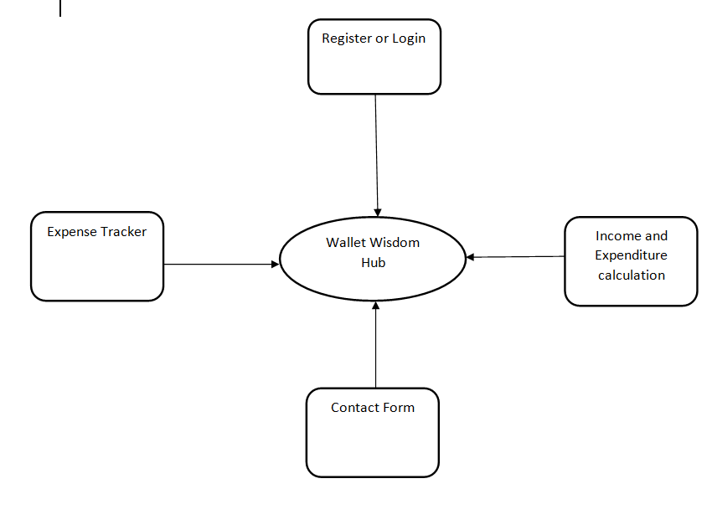
System Architecture
WALLET WISDOM HUB

Slide 8
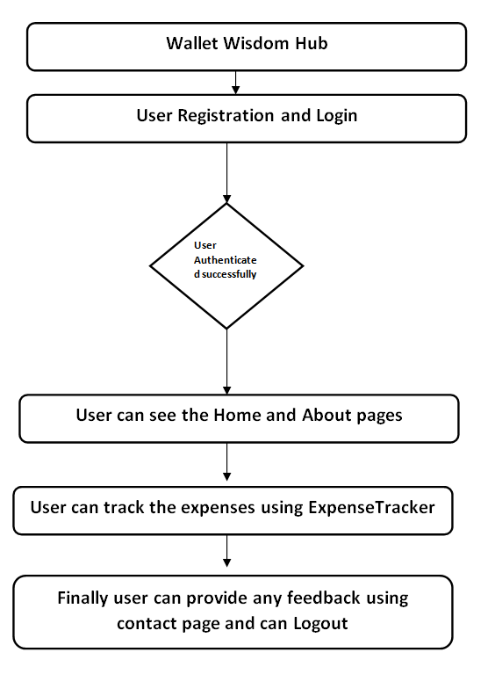
System Design
WALLET WISDOM HUB

Slide 9
System Development Approach
WALLET WISDOM HUB
Frontend Technologies:
HTML (Hyper Text Markup Language):
Utilized for structuring the website and creating the basic layout.
Responsible for defining the elements and content of web pages.
CSS (Cascading Style Sheets):
Employed for styling and formatting the HTML elements.
Ensures a visually appealing and consistent design across the website.
JavaScript:
Implemented for dynamic and interactive features on the client side.
Node.js: Empowers server-side JavaScript development, enabling the creation of scalable and high-performance web applications..

Slide 10
System Development Approach
WALLET WISDOM HUB
Backend Technologies:
PHP (Hypertext Preprocessor):
Used as the server-side scripting language to handle dynamic content.
Responsible for processing user input, managing database interactions, and executing server-side logic.
XAMPP Server:
XAMPP is a cross-platform web server solution that includes Apache, MySQL, PHP, and Perl.
Apache is the web server responsible for serving web pages.
MySQL is the relational database management system (RDBMS) used for storing and retrieving data.
PHP interacts with the Apache server to dynamically generate content and communicate with the MySQL database.
phpMyAdmin:
A web-based tool for managing MySQL databases.
Used for database administration, including creating, modifying, and querying the database.

Slide 11
Algorithm & Deployment
WALLET WISDOM HUB
Expense Tracking Algorithm: Develop an algorithm to track and categorize users' daily expenses automatically. This algorithm can use machine learning techniques to analyze transaction data from linked bank accounts and credit cards, classify expenses into categories (e.g., groceries, utilities, entertainment), and provide users with insights into their spending patterns.
Budget Optimization Algorithm: Create an algorithm to help users set and optimize their budget goals based on their income, expenses, and financial objectives. This algorithm can utilize optimization techniques to allocate funds to different expense categories, prioritize savings and debt repayment, and adjust budgets dynamically based on changing financial circumstances.
Community Engagement Algorithm: Develop an algorithm to foster community engagement and peer support within Wallet Wisdom Hub. This algorithm can encourage users to interact with each other, share experiences and insights, and provide feedback and encouragement, creating a supportive and collaborative environment for financial empowerment.
Continuous Improvement Feedback Loop Algorithm: The continuous improvement feedback loop algorithm collects and analyzes user feedback to drive ongoing enhancements to the app. It employs sentiment analysis, topic modeling, and user segmentation to prioritize feature updates, bug fixes, and usability improvements that align with users' needs and preferences.

Slide 12
Deployment
WALLET WISDOM HUB
Deployment in the context of software development refers to the process of making a developed application or system available and accessible for use. It involves the transition from a development environment to a production environment, where the software can be utilized by end-users. It involves the following :
Database Setup
Server Configuration
Security Measures
Maintenance
User Access

Slide 13
Conclusion
WALLET WISDOM HUB
In conclusion, this Project marks a pivotal endeavor in leveraging technology to address financial challenges faced by individuals on fixed incomes in India. The development of an intuitive and user-friendly expense tracking system serves as a fundamental tool for fostering financial literacy and stability. Through the incorporation of innovative technologies such as user-friendly interfaces and advanced analytics, the project aims to empower users to gain control over their financial well-being. The identified future scope, including the integration of educational resources and the creation of a dedicated mobile application, underscores the commitment to continuous improvement and adaptability to emerging needs. By embracing technological advancements and responding to user feedback, the project aspires to make a lasting positive impact on individuals' financial lives, promoting a sense of empowerment and financial security within the community.

Slide 14
Future Scope
WALLET WISDOM HUB
The future scope of the this Project holds promising avenues for expansion and enhancement to further its impact on improving financial literacy and stability. Here are potential directions for future development:
Enhanced User Experience
Integration with Financial Institutions
Mobile Application Development
Advanced Analytics and Reporting
Educational Resources
Community Engagement
The future scope of the project is dynamic, poised to evolve in response to emerging technologies and user feedback. By remaining adaptable and responsive to the needs of its users, the project can continue to empower individuals to take control of their finances and achieve greater financial stability and well-being.

Slide 15
WALLET WISDOM HUB
References :
https://freefincal.com/mastering-the-art-of-monthly-expense-tracking-and-management/
https://www.linkedin.com/pulse/implementing-expense-tracking-strategy-transform-your-eva-kimathi/
https://www.researchgate.net/publication/360620084_EXPENDITURE_MANAGEMENT_SYSTEM
Notes:
Reference
These are the references for this session.
15

Slide 16
WALLET WISDOM HUB
Thank you!
Notes:
thank you very much for joining this PPT, keep learning.
16

Slide 17
WALLET WISDOM HUB
Video Link of the Project:
Video Link:
https://drive.google.com/file/d/1Homc0wmQ3TiVxUYMikat423NhXBmjQqS/view?usp=drive_link
Github Link:
https://github.com/codeswithganesh/Wallet-Wisdom-Hub
Notes:
thank you very much for joining this PPT, keep learning.
17

